Slide 1
MFM Capacitor
Dutta Lab

Slide 2
Endurance Test at H_{0.5}Z_{0.5}O with 1μs PW and 100ns T_{rise/fall}
After Fine Tuning in cycles
Stress Voltage 2V
Stress Voltage 2.5V
Stress Voltage 3V

Slide 3
Endurance Test at H_{0.5}Z_{0.5}O with 1μs PW and 100ns T_{rise/fall}
After Fine Tuning in cycles
Random
Median
Random stress voltage

Slide 4
Fitting Data with Random Stress Voltage
log(C_{BD})=-5.76v+16.62
SSE | 0.6535
R-square | 0.9695
DFE | 7
Adj R-sq | 0.9651
RMSE | 0.3056

Slide 5
Fitting Data with Uniform Stress Voltage
log(C_{BD})=-5.46v+18.9
SSE | 0.7049
R-square | 0.9845
DFE | 7
Adj R-sq | 0.9822
RMSE | 0.3173

Slide 6
Fitting Data with Uniform Stress Voltage
log(1/C_{BD}) = 3.2736*E - 18.9037
1/C_{BD}
E (MV/cm)

Slide 7
Fitting Data with Random Stress Voltage
1/C_{BD}
log(1/C_{BD}) = 3.4537*E - 19.6168
E (MV/cm)

Slide 8
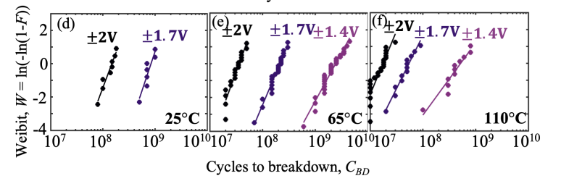

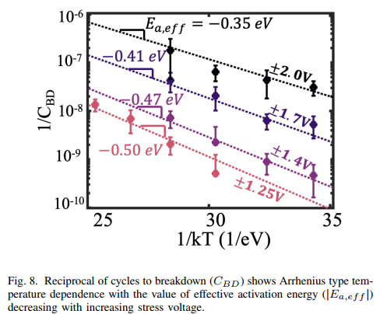
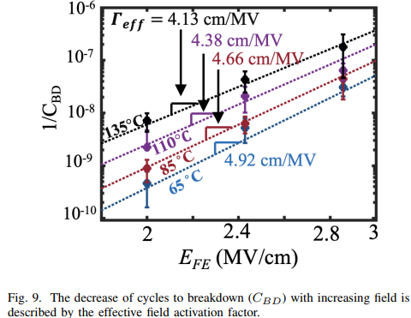

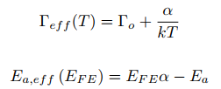
Literature Summary
Failure Rate,
Ref: Ravikumar, Priyanka G. “Comprehensive time dependent dielectric breakdown (TDDB) characterization of ferroelectric capacitors under bipolar stress conditions”. 2024 IEEE International Reliability Physics Symposium (IRPS)

Slide 9
1st Experiment
Initialize Data
Stress Voltage (v) | 2.5 | 2.8 | 3.1 | 2.95 | 2.3 | 2.65 | 2.65
Cycles to Breakdown (Cbd) | 3.00E+05 | 3000 | 100 | 700 | 5.00E+06 | 1.00E+04 | 3.00E+04

Slide 10
Weibull Distribution
ln(C_{BD})
Failure Rate,
3V
2.6V
2.2V
n=123.9849, b=0.9256
n=5129.3206, b=1.2741
n=2677654.3546, b=1.1837
ln(-ln(1-F)) = 0.9256 ln(C_{BD}) - 4.4615
ln(-ln(1-F)) = 1.2741 ln(C_{BD}) - 10.8843
ln(-ln(1-F)) = 1.1837 ln(C_{BD}) - 17.5187

Slide 11
Endurance @ 85⁰C
3V
2.6V
2.2V
85˚C
log(1/C_{BD}) = 3.2897*E -18.1335

Slide 12
Endurance @ 85⁰C
log(1/C_{BD}) = 3*E - 19.9

